Slide 1
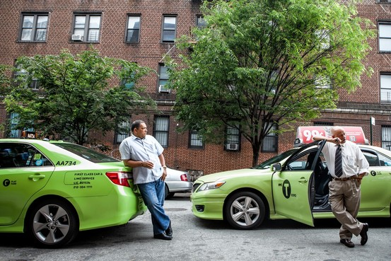
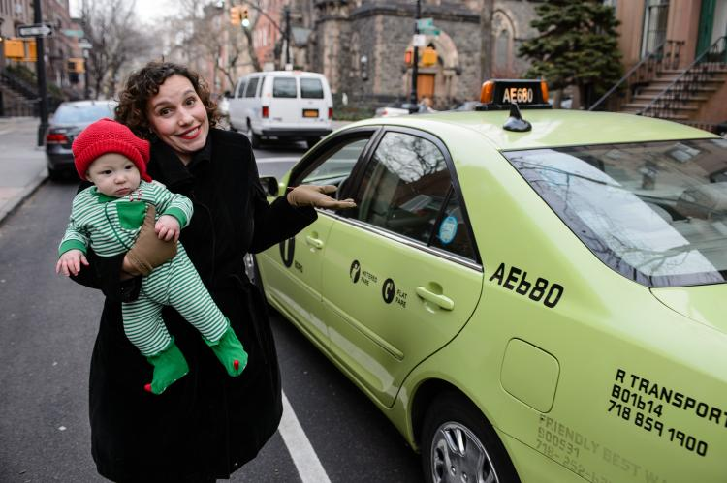
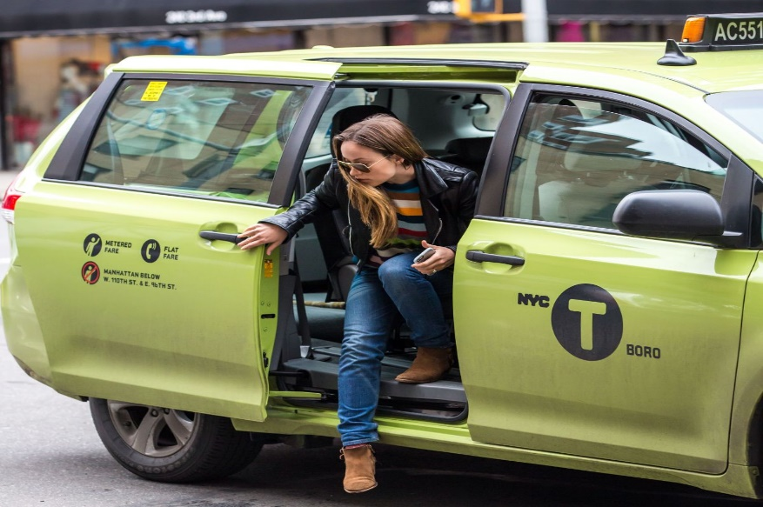
NYC Green Taxi
Case Study & Analysis
Bhanuja Nagore
nagore.b@husky.neu.edu

Slide 2

Table of Contents:
Problem Statement
Approach and Method Used
Analysis – Inter Borough Area
Data Story
Analysis – Intra Borough Area
Data Story
Further Enhancements in Analysis

Slide 3




Problem Statement
Green Taxis (as opposed to yellow ones) are taxis that are not allowed to pick up passengers inside of the densely populated areas of Manhattan
A derived variable for tip as a percentage of the total fare
A predictive model for tip as a percentage of the total fare
Visualization (interactive or static) of the trip data that helps us understand intra- vs. inter-borough traffic
To analyze data set and get inference that are useful in predicting and creates value to the Driver and the passengers

Slide 4
Approach & Methodology:
Data Discovery and Data Cleaning
(Plotting various graphs, bar chart, Histograms to analyze data)
Model Planning
(Hypothesis Testing - One way ANOVA & Clustering)
Model Building
(Linear Regression, Decision Tree and SVM)
Communicate Results
Tableau

Slide 5
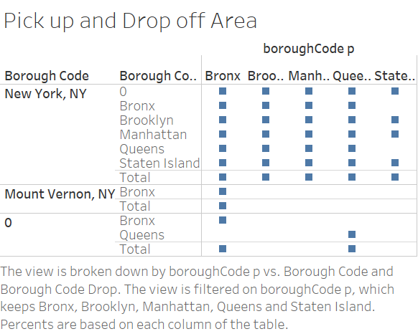
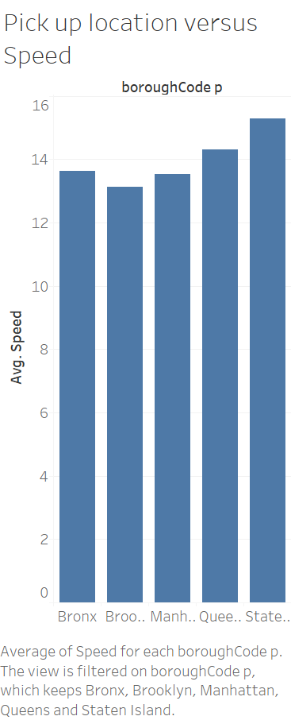
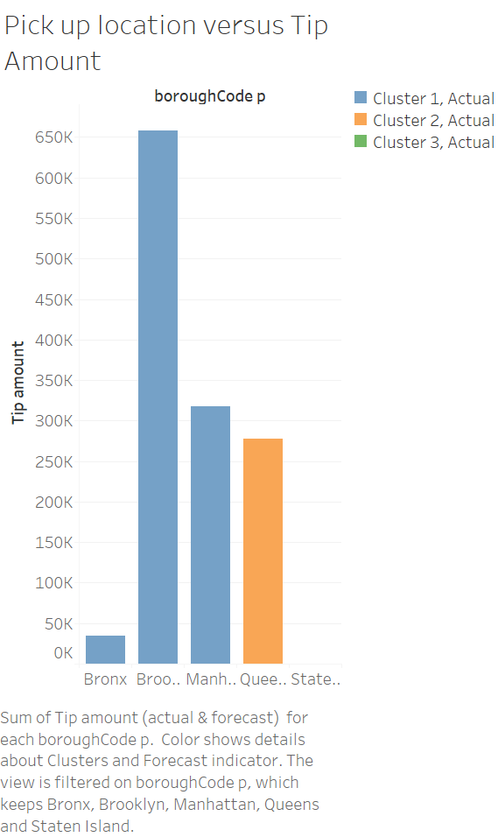
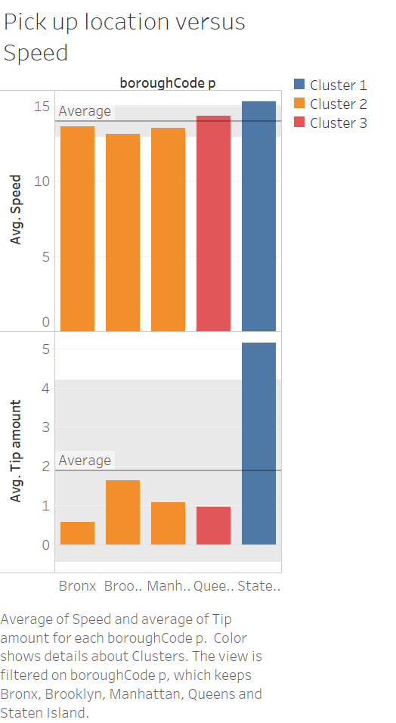
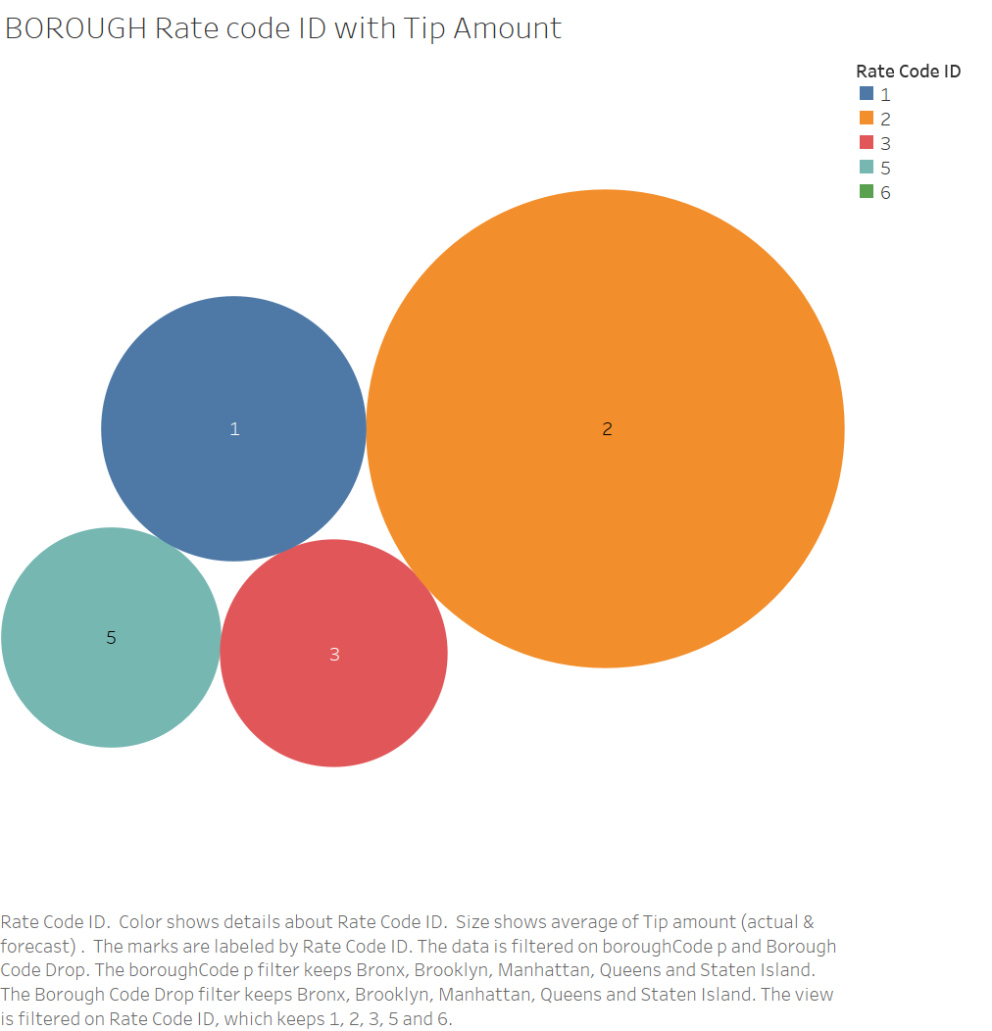
Analysis - Inter Borough Area NY:

Slide 6
Data Story:
About Staten Island Driving pattern:
The Staten Island takes the long trips as the duration is highest for it.
The speed is almost same for all the 5 locations. Only in Staten Island the driver drives with highest speed because the traffic density is less as compared to other locations. We can also infer that the duration is long hence the speed is highest.
The tip amount given in Staten Island is much higher than the other location. Even the duration and speed is highest in this particular area.
The taxi driver will get extra earning in this area “Staten Island” but needs to drive for longer duration.
About 'Brooklyn Driving pattern:
'Brooklyn', the average speed is lowest but the driver earns a substantial amount of tip. It can infer that the passenger who travel in 'Brooklyn' are happy with low speed drive hence they give tips to the driver.
The drivers in 'Brooklyn' earn a good amount of tip. Even they drive for a duration somewhat similar to other location except State Island with low Average speed. The plot reflects an important insight that the passengers travelling to Airport JFK pays more tip as compared to other location.
Airport Tipping Insight:
The passengers travelling to Newark Airport pay less tip to the drivers.
Passengers Appreciate speeding rules:
For rate code Id = 4 “Negotiated Fare” there are cases where driver drives at very high speed and have hardly got any tip from the passenger. The same applies to standard rate too. The plot shows that the passengers have given tips when the driver is driving with a nominal speed. Even passengers appreciate speed as per the rules.

Slide 7
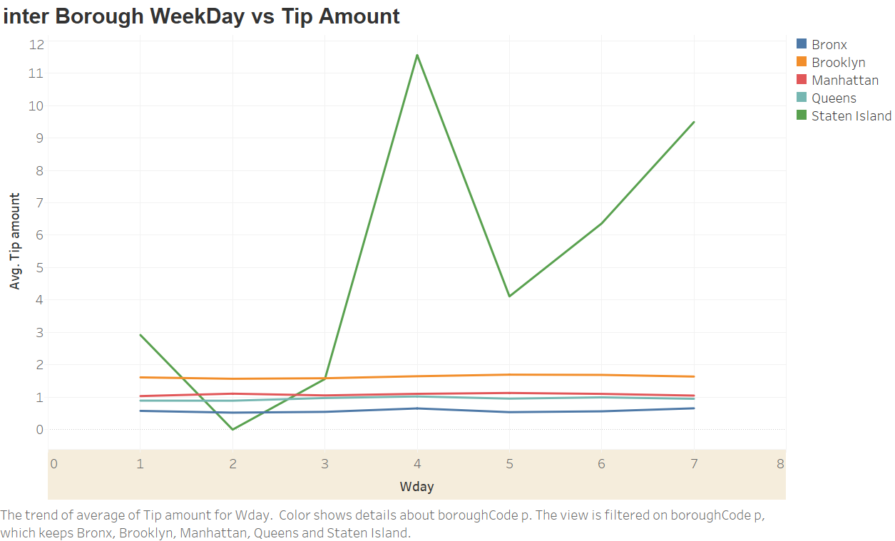
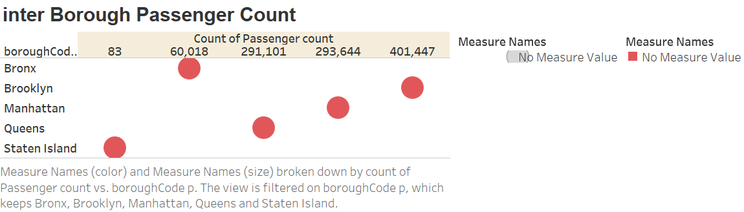
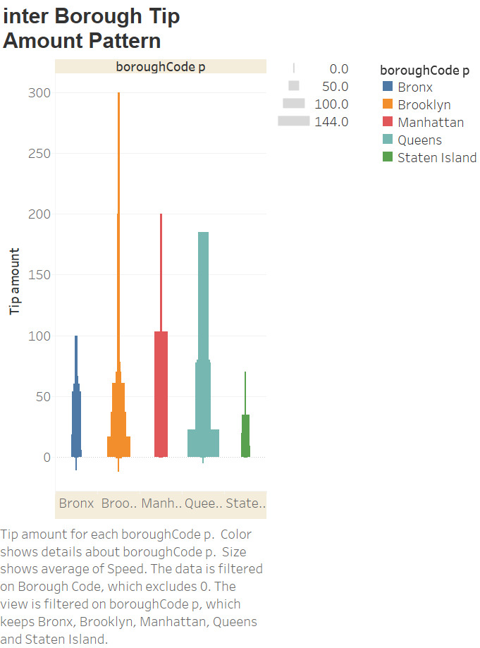
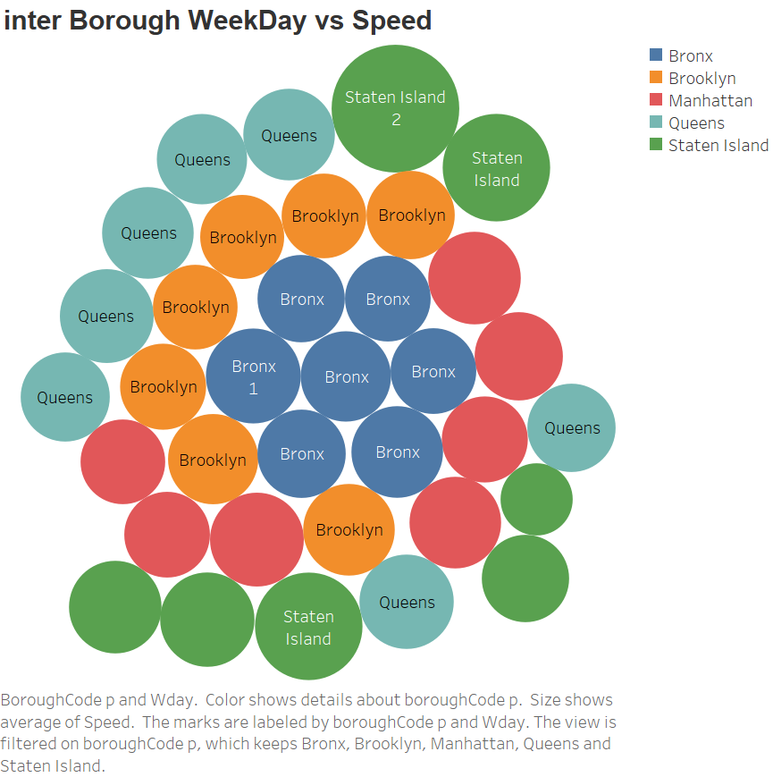
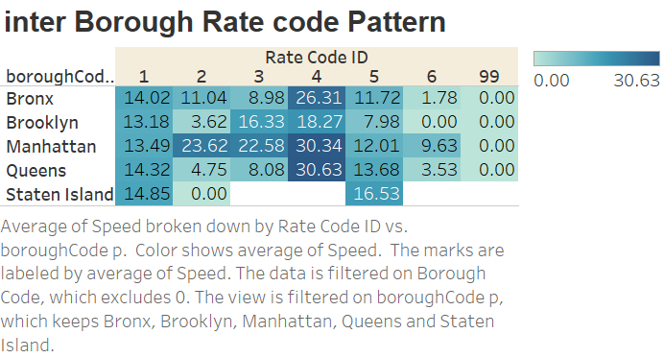
Analysis - Inter Borough Area NY

Slide 8
Data Story:
The average Tip amount is somewhat same for all the regions except the Staten Island. The highest is on 4th day that is Thursday followed by 7th day. The 5th September was holiday, hence most people relaxed at their home.
The highest passengers are from Brooklyn and even the tip amount is more. Hence this shows that in Brooklyn people mostly travel by green taxi and they like slow speed that means relaxed lifestyle.
In Staten island, very few people travel in green taxi.
Interesting facts are from Staten Island that no one travels to airport from green taxi and very few which travels from green taxi are local travelers with standard rates.
The maximum travelers for Airport in JFK and Newark are from Manhattan and they give substantial Tip amount. 293644 number of Travelers from Manhattan are a good amount. The taxi driver should focus more on Manhattan Travelers.

Slide 9
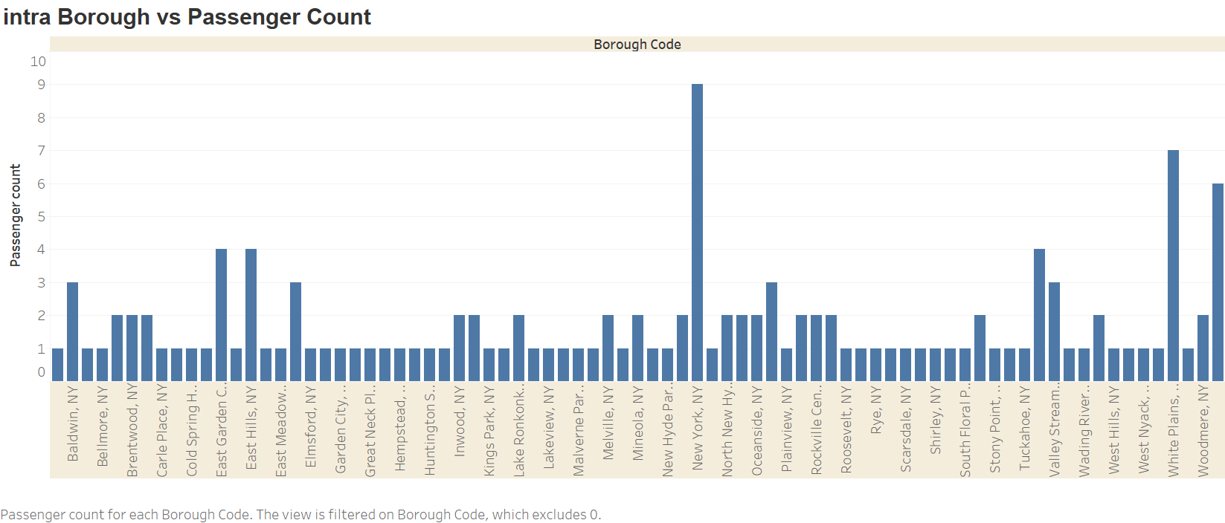
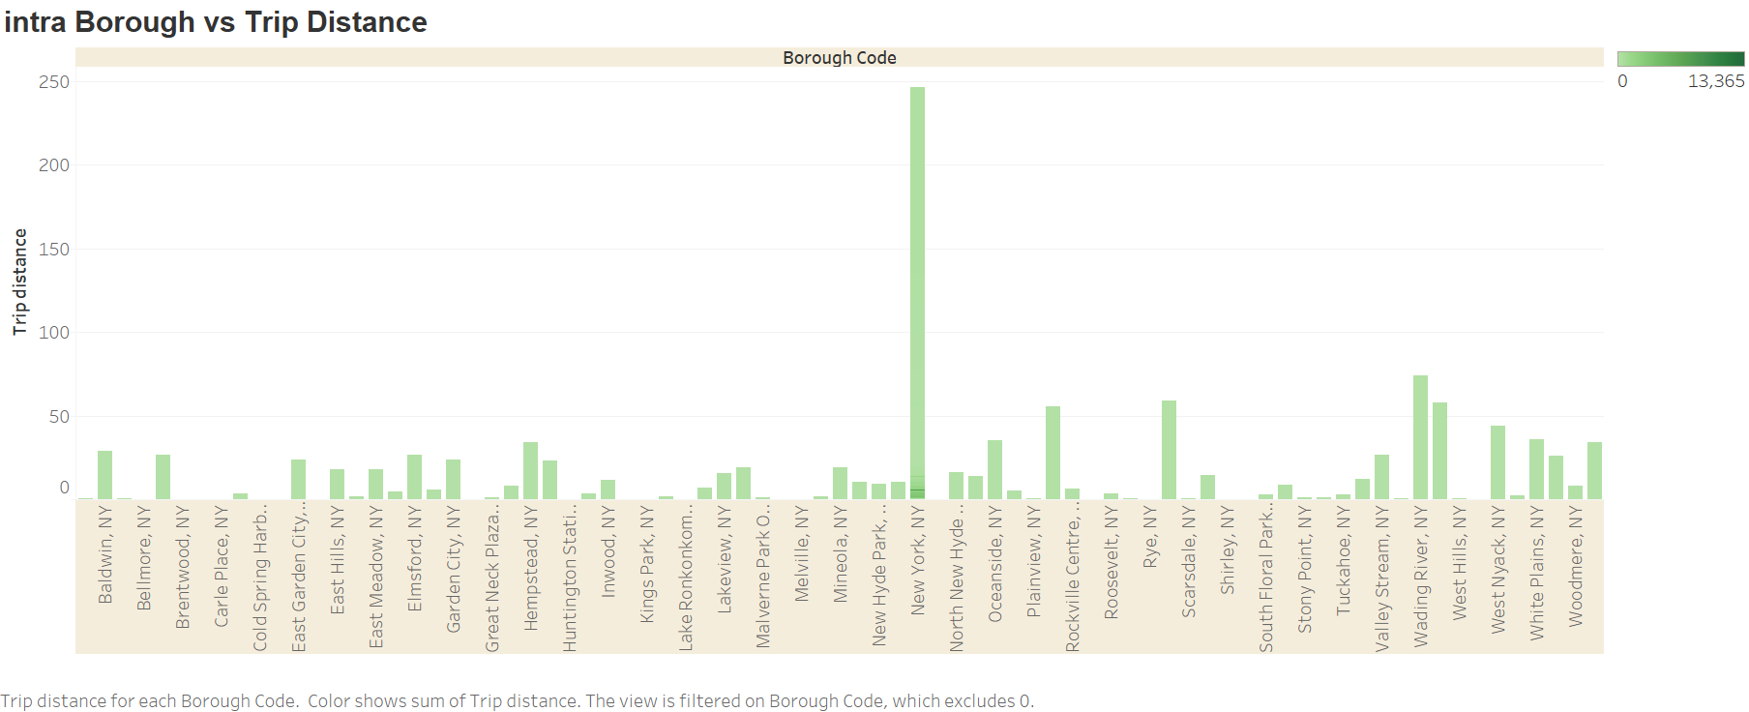
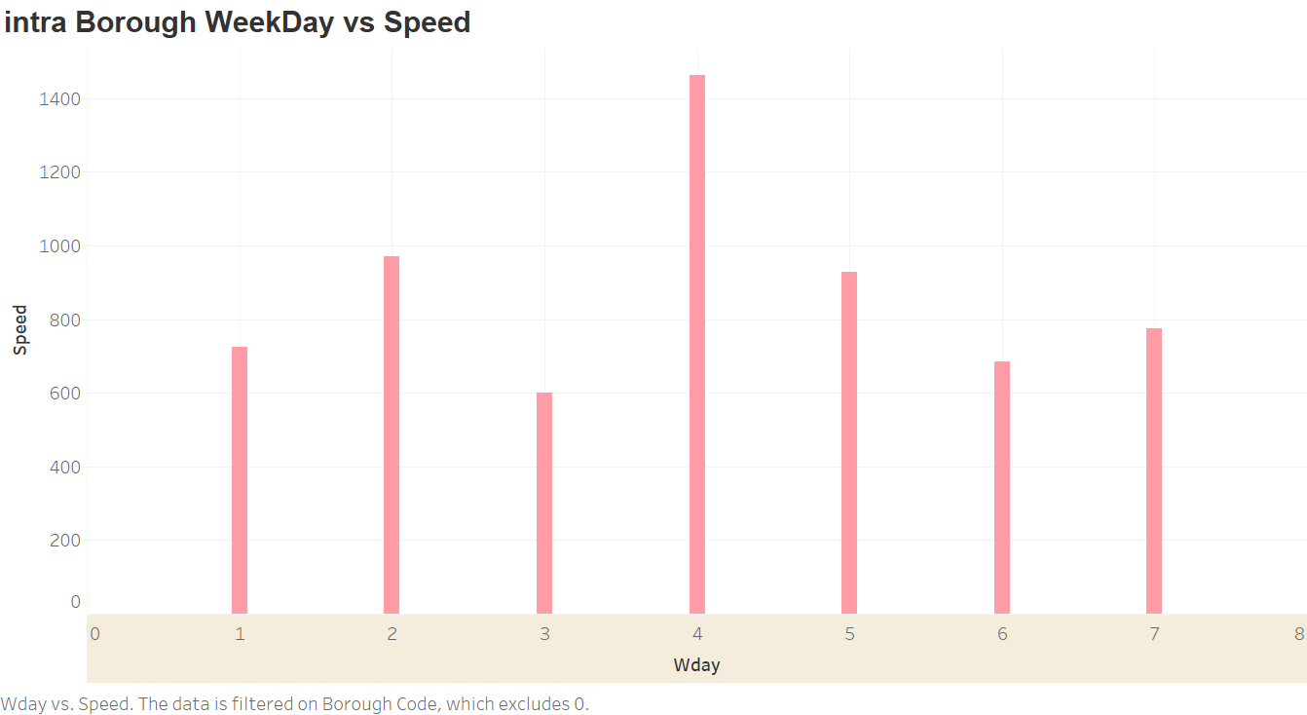
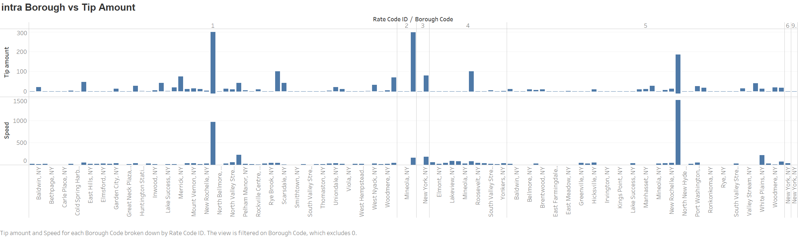
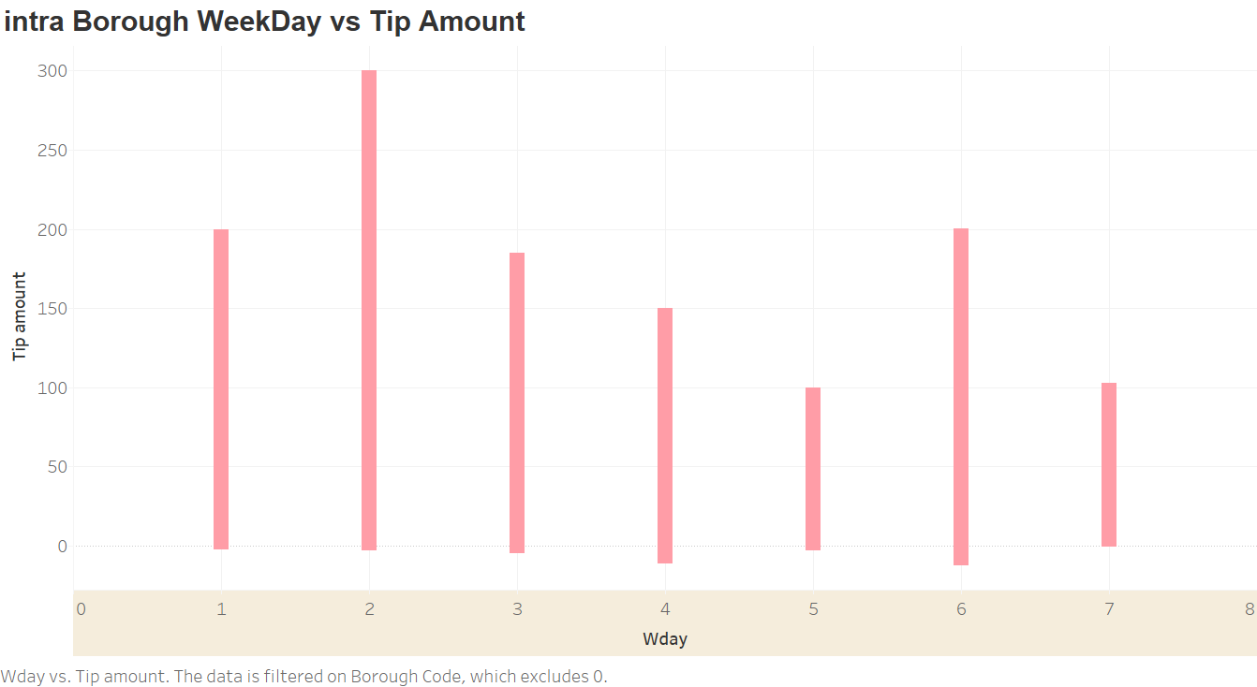
Analysis - Intra Borough Area NY:

Slide 10
Analysis - Inter Borough Area NY:
The maximum passengers travelling are from New York, White Plans and Woodmere
About NY -
The driver drives very fast in New York.
The highest Trip duration is in New York. NY as the trip distance is more.
Traffic Prone Areas -
In Hempstead, Woodmere and Kings Park the duration is more and Trip distance is less. This shows that these are more traffic prone areas as the trip take more time with less distance travelled. Even passengers are not willing to pay Tip amounts as compared to other areas.
Mostly 4th day of the week, the drivers drives fast hence less traffic on road. This can also help us conclude that people may take work from home on the 4th day of the week and therefore no traffic for office.
Tip Pattern -
The highest tips are given for JFK is highest from Mineola ,NY then New Rochelle for standard rate trips.
Highest Tips are earned from New York, Rye, Woodmere and Melville
Passengers mostly give High Tip amounts on 2nd and 6th day of the week. 2nd when they are on work mode and 6th when there are on party(holiday) mode.
On the 6th day that is Saturdays, the tip amount is more than the average, hence passengers pay more tips on Saturdays.
If I had time so would have done analysis on the duration of time – morning, afternoon, evening patterns and its effect on the traffic movement, trip duration and Tip amount.
Mostly people travel with standard rates or negotiated fare in INTRA- BOROUGH Areas.

Slide 11
Further Enhancements in Analysis:
Data Cleaning
To compare the training data with the clean data and the actual data. Plotted graphs of all the variables and outcome with all the three data – Training, Clean and actual. Would have generated a more accurate result on initial data analysis
Training Data
Have taken training data as 2% of the whole data due to the laptop configuration. As the system becomes very slow large chunk of data. Therefore would have used some other system and have tried 60-40 ratio or 80-20 ratio for training and testing data with the model
Analysis on Duration of Time
Have done analysis on the duration of time – morning, afternoon, evening patterns and its effect on the traffic movement, trip duration and tip amount
Analysis on Payment system
Would have analyzed the data more on the payment system. As more transaction are by cash and hence tip amount is not captured for the payment with cash, therefore wanted to analyze the whole model and data w.r.t Payment method. If all the payments are done by cash or credit card, what amount of tip was given to the driver.
To analyze customer behavior on payment system. And if the passengers who pay by cash travel more by taxi or not. Are they economically well , age group, profession, their lifestyle based on week days etc.
Also wanted to apply market basket analysis for trips. Which passenger travels to which area so is likely to go to other areas too.
Presentation
Used Tableau to build a dash board and a story. Would have applied more systematic approach in documentation like all the graphs and tables at the end, analysis at the top.

Slide 12
Thank You !!!

